Slide 1


Slide 2
Optimization of Manufacturing Goods in Supply Chain Management

Slide 3

Project Leadership
Sharat Manikonda
Director at Innodatatics and Sponsor
linkedin.com/in/sharat-chandra

Slide 4
Team Members
Name:
https://www.linkedin.com/profilelink

Slide 5

Contents
Business objective
Business Constraints
Project Architecture
Data collection and details
Exploratory Data Analysis
Visualization
Modeling
Evaluation
Deployment
Notes:
Change

Slide 6
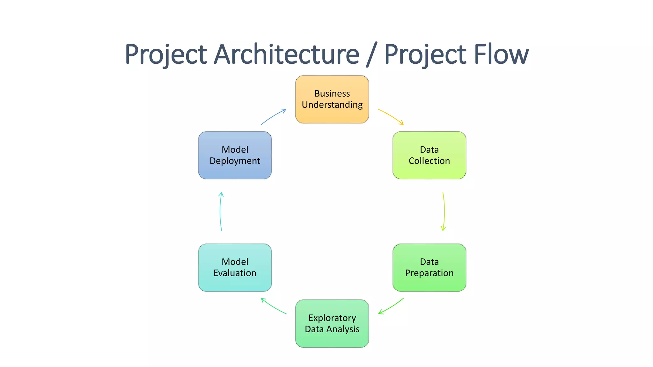
Project Overview and Scope

Slide 7
Business Problem
Demand Fluctuation from Customers
Warehouse Storage issue due to De-hire of excess Pallets

Slide 8
Business Objective
Objective
Constraints
Optimize Storage Space
Minimize Logistical Cost

Slide 9
CRISP-ML(Q) Methodology
There are six stages of CRISP-ML(Q) Methodology
1.Business and data understanding
2.Data preparation
3.model building
4.Model evaluation
5.Model deployment
6.Monitoring and maintenance

Slide 10





Technical Stacks
Jupyter - Python IDLE
Streamlite - Model Deployment
MySQL - Creating databases and retrieving data
Python - Model Building
Anaconda - Open Source python distribution

Slide 11
Project Architecture

Slide 12
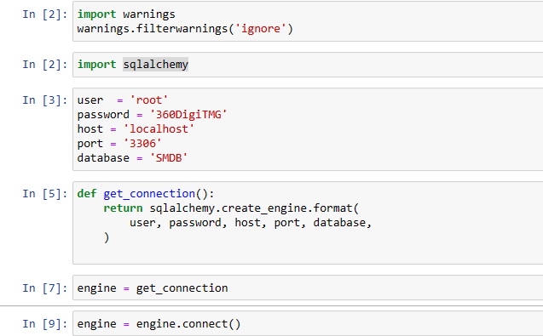
Data Collection and Understanding
SQLAlchemy is a library that facilitates the communication between Python programs and databases.
We extract data from mysql database using SQLAlchemy and create a dataframe at our end

Slide 13
Data Information
data.columns
Index(['POSTING DATE', 'EFFECTIVE DATE', 'CREATE DATE', 'Customer/Vendor Code',
'Customer/Vendor Name', 'LOB', 'Region', 'BP TYPE', 'City', 'STATE',
'From WhsCode', 'From WhsName', 'To whsCode', 'TO WhsName',
'Model TYPE', 'Transfer Type', 'U_Frt', 'U_ActShipType',
'PRODUCT CATEGORY', 'ItemCode', 'QUANTITY', 'UNIT', 'RATE', 'SO ID',
'SO Creation Date', 'SO Due Date', 'U_DocStatus', 'NumAtCard',
'U_SOTYPE', 'BP CATEGORY', 'Document Type', 'Vehicle Type',
'Direct Dispatch', 'Comments', 'U_GRNNO', 'Loading/Unloading',
'Detention', 'KITITEM', 'U_AssetClass'],
dtype='object')

Slide 14
Data Dictionary
Data: The dehire details are obtained from the Pallet manifacturing company and is publicly available for students to access.
Data Dictionary:
Dataset contains 1838 Pallet details
37 features are recorded for each pallet
Description:
Columns name Description
POSTING DATE : Date of product imported for manufacturing
EFFECTIVE DATE :Date of product ready to be manufactured
CREATE DATE :Date of product manufactured
Customer/Vendor Code :Customer Code No.
Customer/Vendor Name :Customer Name
LOB :Commodity Name
Region :Each region
BP TYPE :Business Partner Type
City :City names
STATE :State names
From WhsCode :Warehouse code no. from
From WhsName :Warehouse name from

Slide 15
Data Dictionary
To whsCode : Warehouse code to
TO WhsName : Warehouse name to
Model TYPE : Type of Model
Transfer Type : Type of transfer
U_FrtUnit : fill rate - percentage of customer orders a company can
fulfill without running out of inventory to fill customer orders
U_ActShipType : Means of Transport Shipping of product type
PRODUCT CATEGORY :Category of each product
Item Code :Code of each items Description Description of products
QUANTITY :Quantity of products ordered/purchased
UNITNo : value in this column
RATE :Rate of the product
SO ID :Sale order ID

Slide 16
Data Dictionary
SO Creation Date :Sale Order Creation Date
SO Due Date :Sale Order Due Date
U_DocStatus :Document status of the purchase
NumAtCard :No value in this column
U_SOTYPE :Sale order type
BP CATEGORY :Business Partner Category
Document Type :Document type of the product
Vehicle Type :Type of the vehicle
Direct Dispatch :Direct Dispatch of the product
U_GRNNO :Good Received Note no of the product
Loading/Unloading :Loading and Unloading of the product
KITITEM :Kit item numbers
Notes:
Table change

Slide 17
System Requirements
•Windows 10
•I5 processor
•GPU

Slide 19
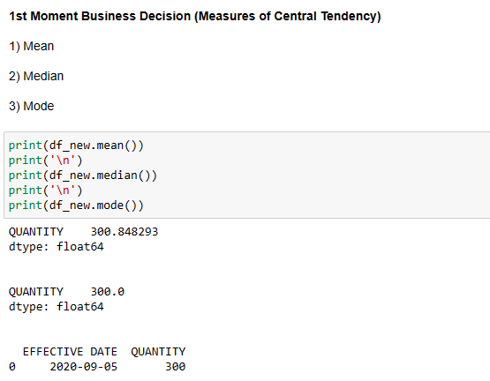
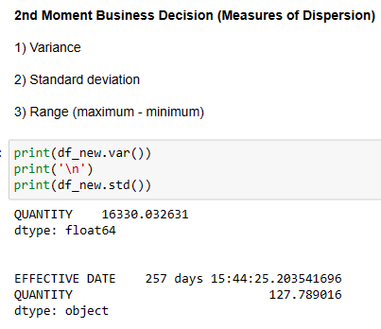
Exploratory Data Analysis [EDA]
Notes:
EDA is used for seeing what the data can tell us before the modeling task.
Change

Slide 20
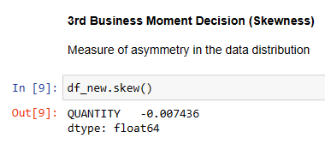
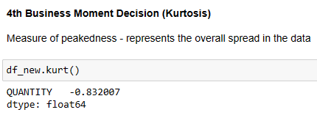
EDA Description
Skewness is negative then the data is represented on right
Mode>Median>Mean.
2. Kurtosis value is negative so the graph is platykurtic.

Slide 21
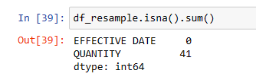
Missing Values Observation
Initially there is no missing value in data .
Date in not in sequence so convert the date into a sequence.
Resample the data.
Replace o by nan value.
There are 41 missing values.

Slide 22
Data Preprocessing
Imputation:
We will apply below following imputations to the null values
•Linear interpolation forward
•Linear interpolation backward
•Polynomial interpolation
•Forward fill interpolation(FFill)
•Backward fill interpolation(BFill)
•Spline imputation
•Cubic imputation
•KNN imputation
Notes:
Keep observations

Slide 23
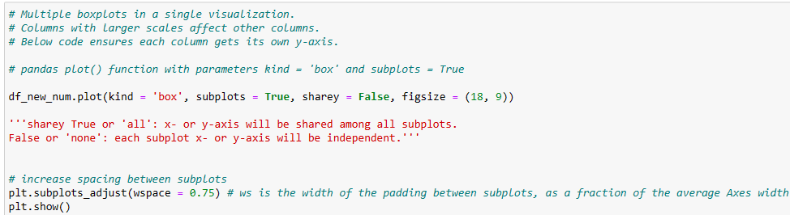
Data Preprocessing
Outliers:
Check whether data has outliers . By using IQR or winsorization method we will replace the outliers with upper bound or lower bound respectively

Slide 24
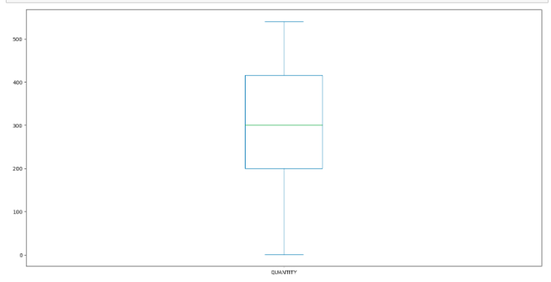
Data Visualization
Notes:
Add graphical

Slide 25
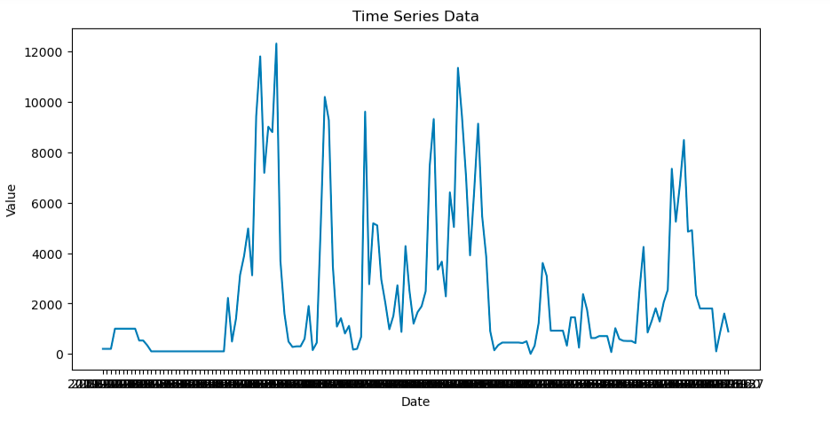
Data Visualization
Time Plot:-
Notes:
Piee

Slide 26
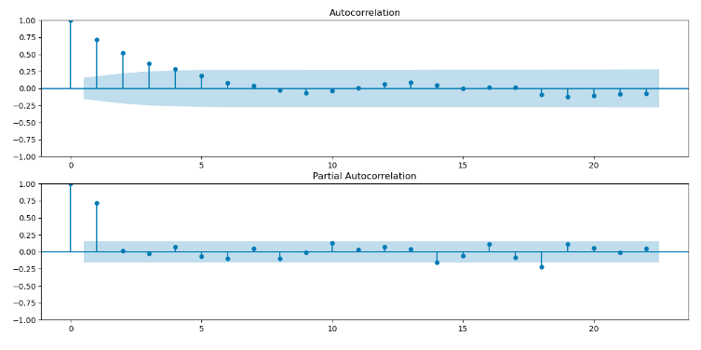
Data Visualization
ACF and PCF Plots:-
Notes:
Piee

Slide 27
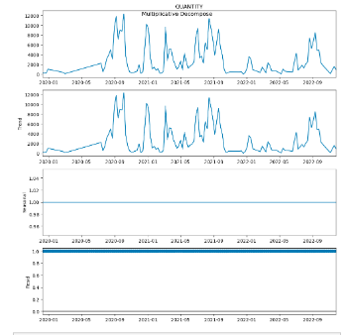
Data Visualization
Sesonal Decomposition:-
Notes:
Piee

Slide 28
Model Building
Algorithm used for model Building:-
ARIMA Model
SARMA Model
Prophet Model
Holts-Winter Model
ARIMA Model (Autoregressive Integrated Moving Average Model) :-
ARIMA Models are specified by three order parameters: (p, d, q),
where,
p - Order of the AR term
q - Order of the MA term
d - Number of differencing required to make the time series stationary
Notes:
classification is the task of predicting a discrete class label. Regression is the task of predicting a continuous quantity.
What is classification techniques in machine learning?
The Classification algorithm is a Supervised Learning technique that is used to identify the category of new observations on the basis of training data. In Classification, a program learns from the given dataset or observations and then classifies new observation into several classes or groups.
What is regression techniques in machine learning?
Regression is a technique for investigating the relationship between independent variables or features and a dependent variable or outcome. It's used as a method for predictive modeling in machine learning, in which an algorithm is used to predict continuous outcomes.

Slide 29
Model Building –
SARIMA Model:-
SARIMA are ARIMA models with a seasonal component. Per the formula SARIMA(p,d,q)x(P,D,Q,s), the parameters for these types of models are as follows:
p and seasonal P: indicate number of autoregressive terms (lags of the stationarized series)
d and seasonal D: indicate differencing that must be done to stationarize series
q and seasonal Q: indicate number of moving average terms (lags of the forecast errors)
s: indicates seasonal length in the data
Two approaches were taken to determine the ideal SARIMA parameters: ACF & PACF Plots and a grid search.
Notes:
What is the role of regression in ML
Is regression supervised or unsupervised?

Slide 30


Model Building –
Holts Winter model:-
The Holt-Winters method uses exponential smoothing to encode lots of values from the past and use them to predict “typical” values for the present and future.
Prophet Model:-
Prophet is a procedure for forecasting time series data based on an additive model where non-linear trends are fit with yearly, weekly, and daily seasonality, plus holiday effects. It works best with time series that have strong seasonal effects and several seasons of historical data. Prophet is robust to missing data and shifts in the trend, and typically handles outliers well.

Slide 31
Model Accuracy Comparison
Allot model | MAPE
ARIMA | 3.5
SARIMA | 2.28
Prophet | 2.1
Holts-Winter | 4.3

Slide 32
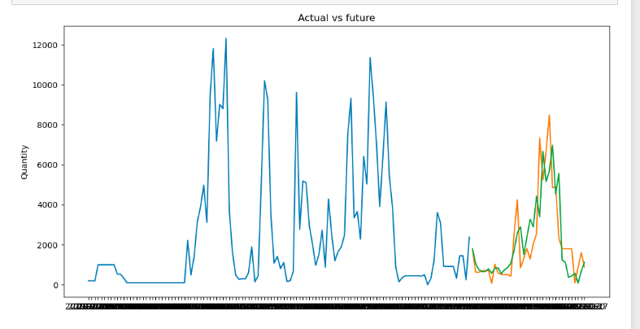
Best Model –
SARIMA IS BEST MODEL
Notes:
Why Random Forest Regression is good?
A Random Forest Regression model is powerful and accurate. It usually performs great on many problems, including features with non-linear relationships
How is XGBoost different from random forest?
One of the most important differences between XG Boost and Random forest is that the XGBoost always gives more importance to functional space when reducing the cost of a model while Random Forest tries to give more preferences to hyperparameters to optimize the model..
n_estimators — the number of decision trees you will be running in the model

Slide 33
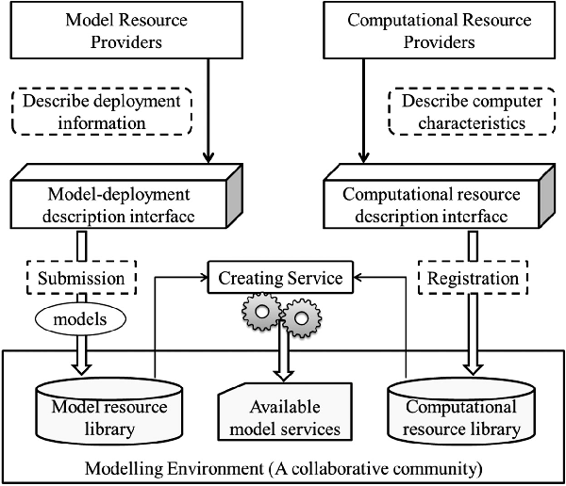
Model Deployment - Strategy

Slide 34
Screen shot of output

Slide 35
Screen shot of output

Slide 36
Screen shot of output

Slide 37
Video of output

Slide 38
Challenges

Slide 39
Future Scopes

Slide 40

Queries ?

Slide 41


